Slide 1
Five Minerals Powder
Five Minerals Powder (五石散), or Cold-Food Powder (寒食散), was a poisonous psychoactive drug popular during the Six Dynasties (220–589) and Tang Dynasty (618–907) periods of China.
Ingredients: stalactite(钟乳石), fluorite(紫石英), quartz(白石英), sulfur(硫磺), red halloysite(赤石脂)——《魏晋风度及文章与药及酒之关系》(鲁迅)

Slide 2
2
Current Situation
2.1
Drugs
Content
2.2
Alcohol&Tobacco
1.3
Five Minerals Powder
1.4
Chinese alchemy

Slide 3
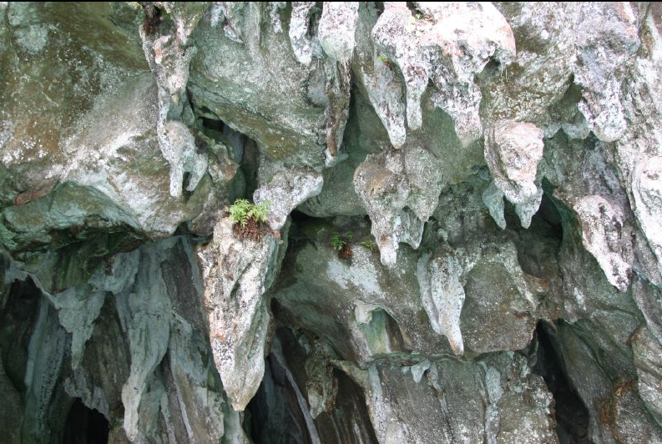
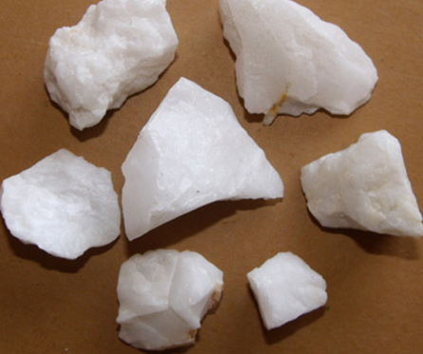
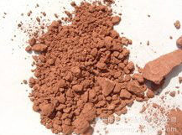
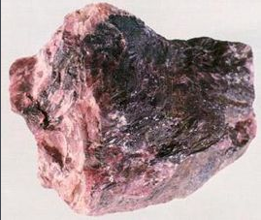
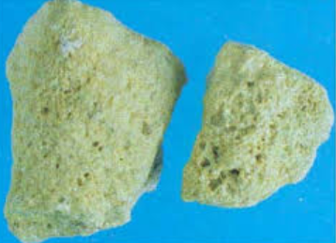
Five Minerals Powder
stalactite(钟乳石)
quartz(白石英)
red halloysite(赤石脂)
fluorite(紫石英)
sulfur(硫磺)

Slide 4
Five Minerals Powder
Effects:
Fever symptoms: Fever, needs “cold food”
Behavioural disorders: experience of depression and suicidal tendencies
Aphrodisiac(春药)

Slide 5
Five Minerals Powder
Skin troubles:
1. all kinds of "rottenness" of flesh;
2. cutaneous disorders like abscesses, ulcers, especially on the legs and on the back.

Slide 6
Five Minerals Powder
Influence on daily life:
Scholars generally associate the drug with the scholar-gentry social class
Wearing clogs（木屐） and loose clothes because their skin easily scraped
Prefer old clothes, many bugs on their body

Slide 7
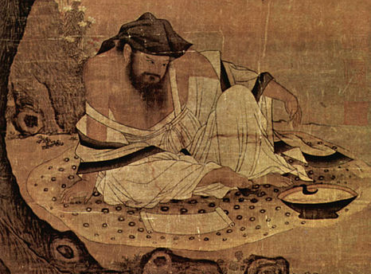
Tao Yuanming (365?–427)

Slide 8
Chinese alchemy
Chinese alchemy is an ancient Chinese scientific and technological approach to alchemy, a part of the larger tradition of Taoist body-spirit cultivation developed from the traditional Chinese understanding of medicine and the body.
Outer alchemy（外丹）

Slide 9
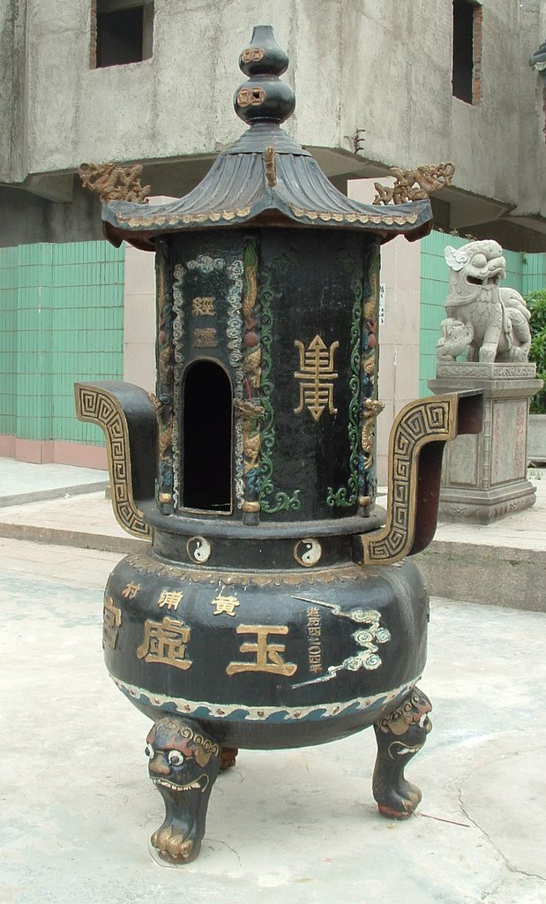
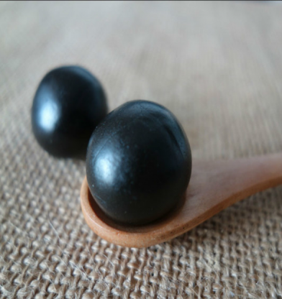
Chinese alchemy
Dan(丹)
Alchemy furnace(炼丹炉)

Slide 10
Chinese alchemy
Dan made from cinnabar(朱砂), realgar(雄黄), and other substances generally involving mercury(汞), sulfur(硫), lead(铅), and arsenic(砷) or else the animal and botanical products which are found in Chinese herbology and Traditional Chinese medicine.

Slide 11
Chinese alchemy
Usage:
Extend life of human
Aphrodisiac(春药)
Immortal

Slide 12
Chinese alchemy
Effects:
Mercury poisoning
Unconscious in daily life
6 Emperors of the Tang Dynasty died because of Chinese alchemy
Disturb people's lives and political situation

